Slide 1
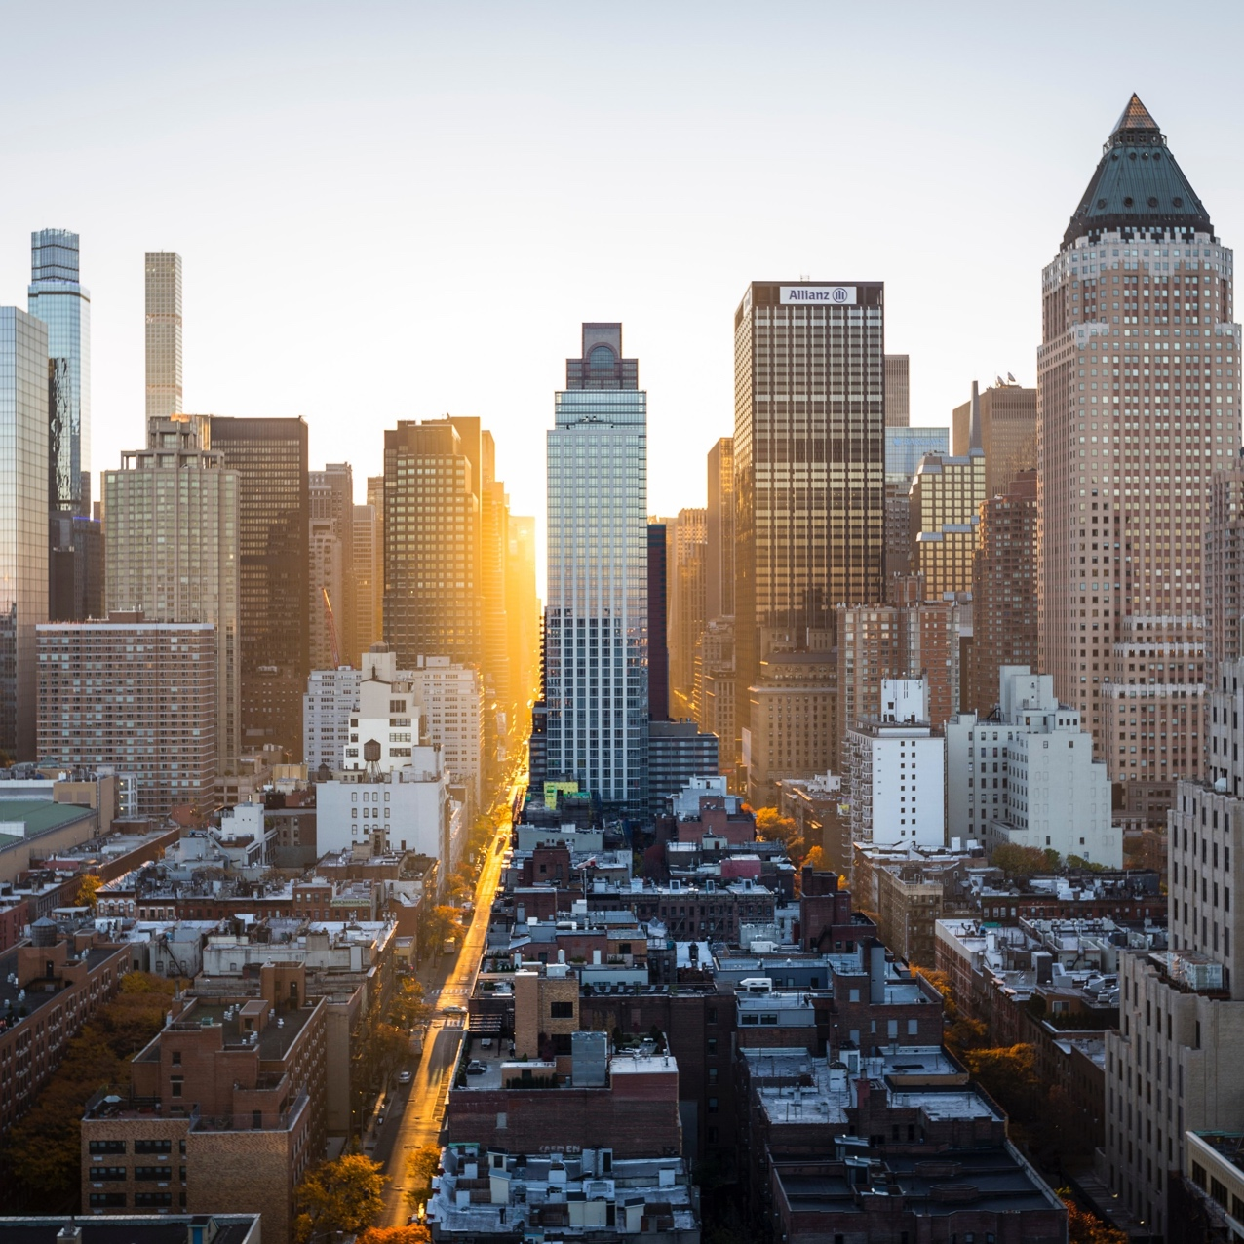
The capital project
Pitch deck v0.1

Slide 2
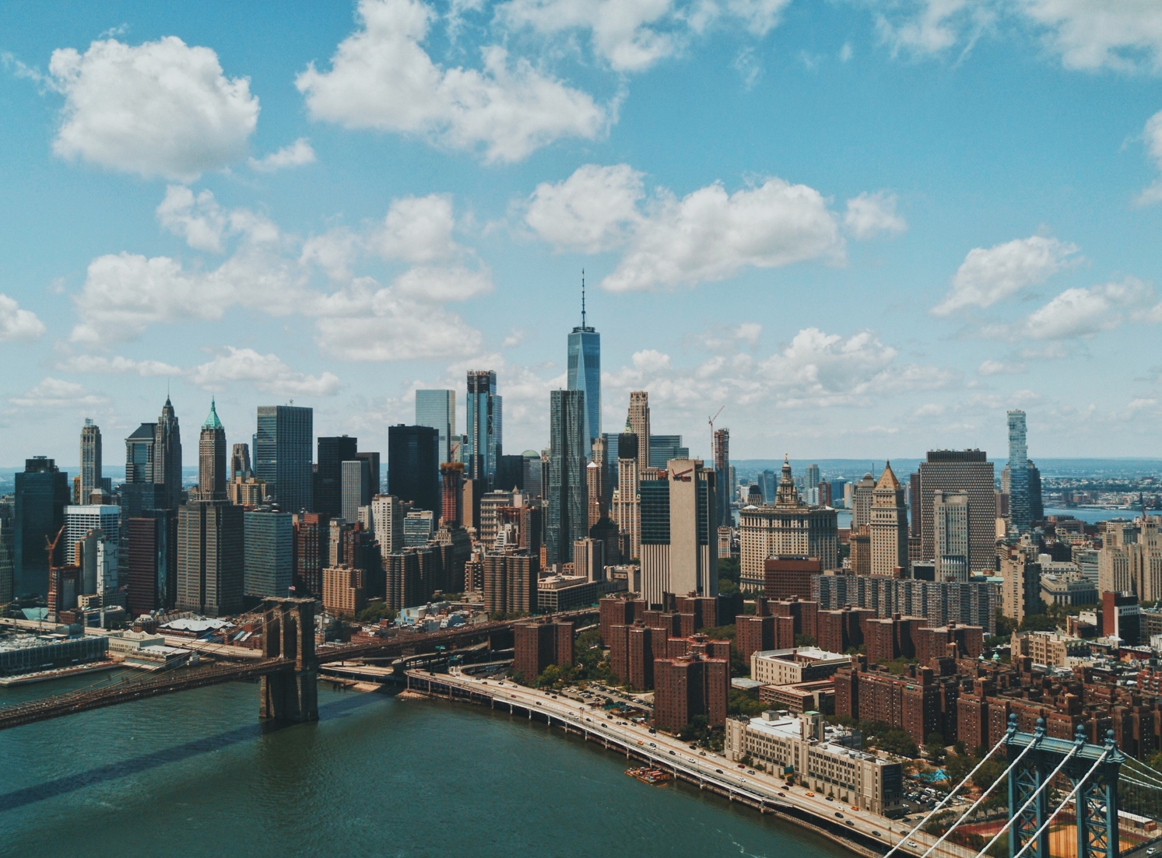
Problem Statements
Why it started:
current undesirable situation, its impacts, and the ideal state we prefer instead

Slide 3
PROBLEM STATEMENTS
Some or all of the following statements are true:
Having a work-life balance is not an easy task.
I want to, but do not know or too busy to improve myself.
I have no time to do or explore other things.
Healthy & positive social networking is impossible.
If I lose my current job, that would be the end.
I still cannot find the purpose of my life.
I am still looking for my passion.
There is no place/facility for me to learn something new.
There are too many places/facilities for me to learn something new, I am confused.
I need constructive feedback.
I need motivation and learning buddy.
I am always stuck at planning phase.
I easily give up.
Those statements are related and negatively impact one another. I want to do something: address the issues and improve my condition.

Slide 4




foundational concepts
Work-Life Balance
Continual Improvement, Kaizen
Ikigai
Portfolio, Portfolio Career, Work-Life Integration

Slide 5


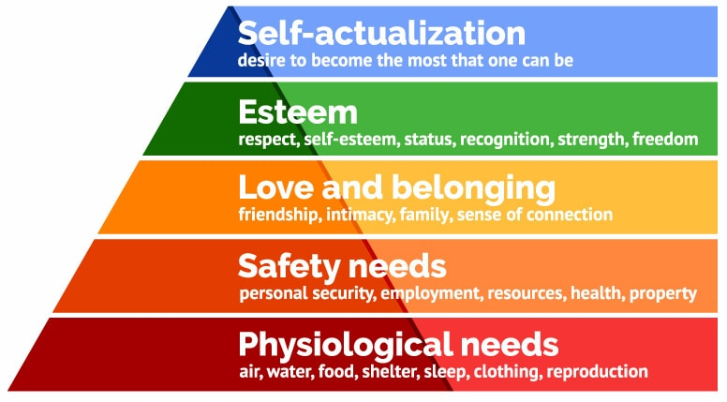
Work-life balance
Maslow’s Hierarchy of Needs
Definition
tips
A concept that describes the prototype of splitting one's time and energy between work and other important aspects of their life.
It is the state of equilibrium in which demands of personal life, professional life, and family life are equal.
Areas of life other than work–life can include personal interests, family and social or leisure activities.
Let go of perfectionism
Unplug
Exercise and meditate
Limit time-wasting activities and people
Change the structure of your life
Start small. Build from there.

Slide 6
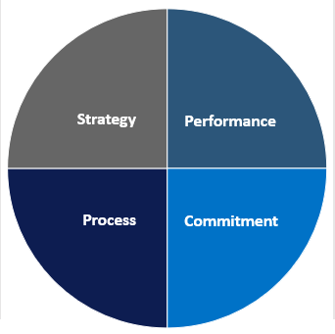

Continual improvement
Performance measures
Management purposes
Vision & mission
Deliverables
Definition
PDCA Cycle
The ongoing improvement of products, services or processes through incremental and breakthrough improvements.
Delivery (customer valued) processes are constantly evaluated and improved in the light of their efficiency, effectiveness and flexibility.
Quality
Plan: Identify an opportunity and plan for change.
Do: Implement the change on a small scale.
Check: Use data to analyze the results of the change and determine whether it made a difference.
Act: If the change was successful, implement it on a wider scale and continuously assess your results. If the change did not work, begin the cycle again.
Process mapping
Process analysis
Compelling awareness
Shared goals

Slide 7
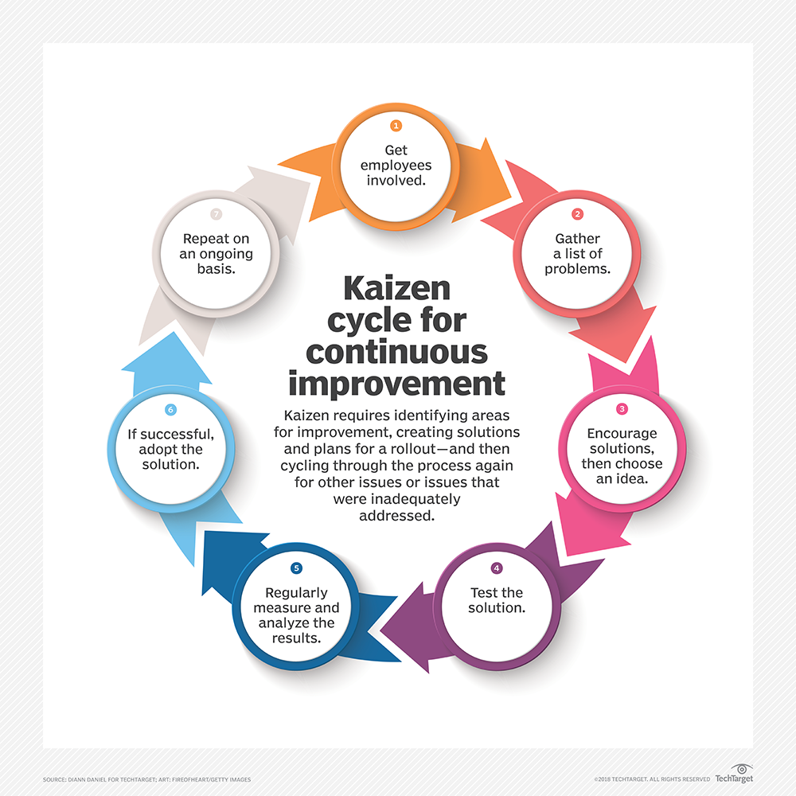

Kaizen
Definition & principles
Key features
改善
kai (change) + zen (good) = improvement
Feedback: (self) reflection of processes.
Efficiency: identification, reduction, and elimination of suboptimal processes.
Evolution: incremental, continual steps rather than giant leaps.
Improvements are based on many small changes rather than the radical changes.
The ideas come from the workers themselves.
Small improvements are less likely to require major capital investment than major process changes.
All employees should continually be seeking ways to improve their own performance.
It helps encourage workers to take ownership for their work, and can help reinforce team working, thereby improving worker motivation.

Slide 8
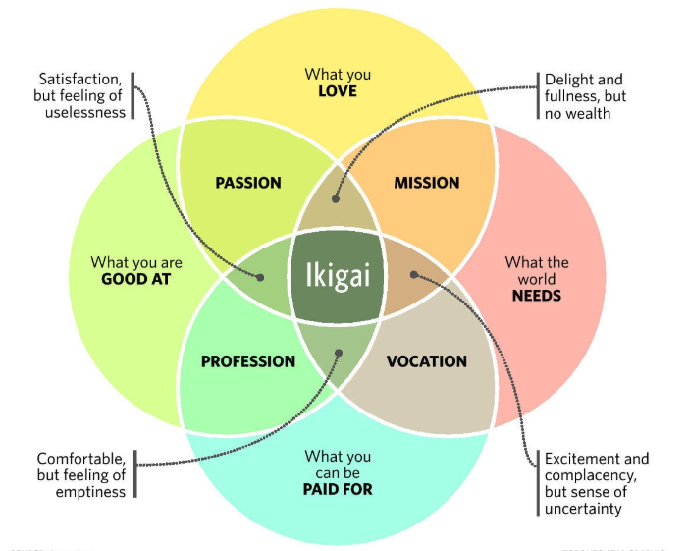

ikigai
Definition & principles
10 helpful rules
生き甲斐
iki (to live) + gai (reason) = a reason for being
A direction or purpose in life which makes one's life worthwhile, and towards which an individual takes spontaneous and willing actions giving them satisfaction and a sense of meaning to life.
Stay active and don’t retire
Leave urgency behind and adopt a slower pace of life
Only eat until you are 80 per cent full
Surround yourself with good friends
Get in shape through daily, gentle exercise
Smile and acknowledge people around you
Reconnect with nature
Give thanks to anything that brightens our day and makes us feel alive.
Live in the moment
Follow your ikigai

Slide 9

Portfolio
Work & Career
Work-Life Integration
definition
Home &
Family
Wellbeing &
Health
Portfolio career
A compilation of materials that exemplifies your beliefs, skills, qualifications, education, training and experiences. It provides insight into your personality and work ethic.
A collection of their best work intended to showcase one's style or method of work. It serves as a proof of one's skills, abilities, and potential in the future.
A career that incorporates lots of different industries, roles, jobs, skills, and interests.
Work-Life Integration
Skillset diversity
Innovation and experimentation
Personal branding
Broader experience range
Comprehensive services to clients
Community & Connecting

Slide 10
Background
How it started…

Slide 11

capital project
A capital project is a long-term project to build, improve, maintain, or develop a capital asset that involves a significant and consistent flow of investment.
Characteristics:
large scale
costs a lot of money, management, resources
lasts a long time
generally extremely complex

Slide 12
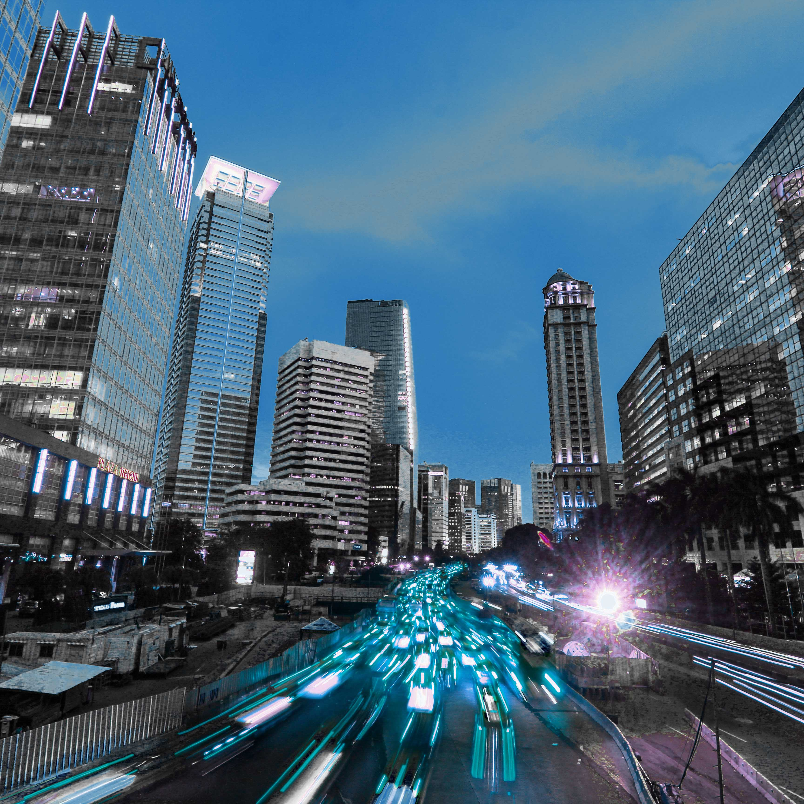
capital Asset
Capital assets include land, buildings, machinery, factories, vehicles, and computer equipment.
Examples: construction projects such as building a new factory, adding a new pipeline or maintaining an old building.
A business may start a capital project to increase growth or to maintain assets. A company may invest in new facilities, a manufacturing process, or internal systems.
Capitals are elements that are needed for a business to be able to deliver its products and/or services; anything that increases one’s ability to generate value.
Asset is a useful or valuable thing, person, or quality.

Slide 13

Positive psychological capital
Positive psychological capital is the positive and developmental state of an individual as characterized by high self-efficacy, optimism, hope and resiliency.
Classical psychological goals:
Help ordinary people to live a more productive and meaningful life.
A full realization of the potential that exists in the human being.

Slide 14

Positive psychology
2 branches of positive psychology:
Positive organizational scholarship.
Positive organizational behavior (POB), focuses on valid measures of positive- psychological states that are open to development and have impact on desired employee attitudes, behaviors, and performance.

Slide 15

psychological Capital
4 psychological resources/constructs/capitals:
Hope – a positive motivational state where two basic elements - successful feeling of agency (or goal oriented determination) and pathways (or proactively planning to achieve those goals) interact.
Efficacy – people's confidence in their ability to achieve a specific goal in a specific situation.
Resilience – a positive way of coping with adversity or distress; an ability to recuperate from stress, conflict, failure, change or increase in responsibility.
Optimism – a realistic construct that regards what an employee can or cannot do, as such, optimism reinforces efficacy and hope.
Also known as the HERO within.

Slide 16
Capital Breakdown
Physical Capital
Financial Capital
Intellectual Capital
Human Capital
Knowledge and skills
Work-related experience
Competencies
Vocational qualification
Employee engagement
Emotional intelligence
Entrepreneurial spirit
Flexibility
Employee loyalty
Employee satisfaction
Education
Creativity
Attitude
Motivation
Relational Capital
Formal relationships
Informal relationships
Social networks
Partnerships
Alliances
Brand images
Trust
Corporate reputation
Customer loyalty
Customer engagement
Licensing agreements
Distribution agreements
Joint venture
Structural Capital
Organizational culture
Corporate values
Social capital
Management philosophy
Processes and routines
Formal processes
Informal routines
Management processes
Intellectual property
Brand names
Data and information
Codified knowledge
Patents/copyrights
Trade secrets

Slide 17
INTRODUCTION
to the Capital Project

Slide 18

The capital project
“An online (and offline) ecosystem that offers portfolio repository system and allows members to contribute in solo or group projects for community learning and improvement.”

Slide 19


systems
A system/regulation that defines how the Capital Project works, including the portfolio repository system, citizenship, meetings, project execution and documentation.
The central system is maintained and refined by the council.
The council is limited to 30 people. The council members are reviewed and assessed every cycle.
Revision/authorization of the central system is done in a council meeting.
A council meeting is conducted at least once every cycle.
Official members of the Capital Project is referred to as a citizen. A citizen can propose him/herself or be recommended to be a council member.
Portfolio Repository System
Referred to as “repository” or simply “repo”.
A platform where contributors put all the working files and documents. It serves as file system, storage, version control, and archive.
Recommended platforms: Github, Sourcetree.
The Central System

Slide 20
Project
A series of tasks that is planned, designed, and executed to achieve a particular aim.
There are 2 types of projects: solo project (designed and executed by 1 person) and group project (designed and executed by more than 1 person).
A project is initiated by 1 or more customers. These customers are responsible to define the project requirements, project specification and deliverable expectations.
A project is executed by 1 or more creators (co-creators). They are responsible to design, create and finish the project based on the project requirements.
A project’s deliverable is tested and reviewed by consumers. Consumers can give score and feedback, pinpoint defects/errors, and give potential improvements or features to add in future releases.
A person can be customer and creator in the same project.
A project should have deliverable. Deliverables can be in form of document, video, application, website, or product (software/hardware).
Examples of projects: creating a cooking tutorial video; designing an infographic about first aid; building a reminder mobile application; creating a short movie; building a house alarm system.
A project’s complexity level will be assessed and categorized.

Slide 21

Cycle & Circle
A circle is a small-to-medium group of people who are expected to collaborate during a cycle. A circle is rearranged every cycle.
Each circle conducts circle meeting every month (direct/virtual meeting).
In the circle meeting, citizens can discuss their cycle progress, ongoing and future projects.
In the circle meeting, there will be coaching class. A coaching class is a session where 1 citizen acts as a coach to share knowledge/idea/skill to participants. Each citizen should be a coach at least once in every cycle.
A cycle lasts for about 15 minutes. The coach is accompanied by a personally-created presentation/infographic.
The schedule of coaches can be predetermined, randomized, voted, or voluntary. The topic can be predetermined, voted, randomized, or free up to the coach.
cycle
Cycle is a time unit used in the Capital Project. One cycle is a 6-month period (Jan - Jul, Jun - Dec).
A cycle meeting will be conducted at the end of every cycle. Cycle meeting can be joined by citizens from different circles, depending on the situation and availability.
The purpose of cycle meeting is to review the cycle and circle that is about to end, and plan the next cycle and circle.
In every cycle iteration, each citizen should create cycle commitments for the upcoming cycle, and review his/her cycle commitments from the ongoing cycle.
circle

Slide 22





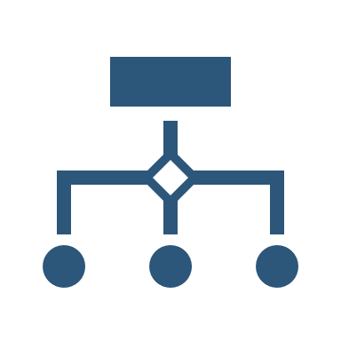




The Capital Project Ecosystem
The Capital Project Ecosystem
Cycle
Portfolio Repository System
Council Meetings
Projects 1 Project 2 Project 3
Cycle Meetings
Cycle Commitments
Circle
The Central System
Solo
Group
Solo
Contributions
Initiate & Define
Create & Execute
Test & Review
Circle Meetings
Coaching Classes

Slide 23


Vision & Mission
To provide platform for growth and self discovery.
To present opportunity for people to collaborate.
To design a system that can serve as a model.
vision
Productive community that helps individuals to be fulfilled and contributive to the society.
mission

Slide 24

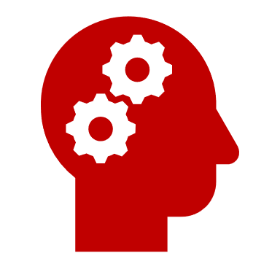



Core values
Scope : output
Focus : the effort contributed by a person in bringing about a result; a voluntary gift (money, service, ideas) made to someone worthwhile cause.
Value : the ability to assess and initiate things independently; the power or opportunity to act or take charge before others do; an act or strategy intended to resolve a difficulty or improve a situation; a fresh approach to something.
CONTRIBUTION
initiative
Scope : individual
Focus : the mental and moral qualities distinctive to an individual.
Value : the quality of being honest and having strong moral principles; moral uprightness; the state of being whole and undivided.
Scope : group
Focus : a group of people living in the same place or having a particular characteristic in common; a feeling of fellowship with others, as a result of sharing common attitudes, interests, and goals.
Value : the quality or state of being closely connected or appropriate.
CHARACTER
integrity
COMMUNITY
relevant
Scope : time
Focus : the arts and other manifestations of human intellectual achievement regarded collectively; the attitudes and behaviour that are characteristic of a particular social group; all the knowledge and values shared by a society.
Value : the ability to be maintained at a certain rate or level.
Scope : space
Focus : the maximum amount that something can contain/produce.
Value : the quality of being as much as is appropriate or fair; moderateness; sound judgment.
CULTURE
sustainable
CAPACITY
reasonable

Slide 25

5w+1h analysis
Who?
20s; youth; Generation Z.
Why?
Preserve, develop, and maximize the legacy of the ancestors.
Optimize the present.
Prepare for the future generations.
Where?
City > Country > Continent.
When?
Conceptually, now. Concretely, based on timeline.
What?
Fulfill the core values, achieve the missions and realize the vision.
How?
Start the projects.

Slide 26

team
Bryan
tba
tba
tba
Citizen
TBA
TBA
TBA

Slide 27
Milestones
Cycle | Month | Year | Number | Milestone | Remarks
000 | April – June | 2020 | 1 | Central System design is finished
 |  |  | 2 | Portfolio Repository System is ready
 |  |  | 3 | 3 projects initiated | Total: 3 projects initiated
001 | July – December | 2020 | 4 | The Capital Project phase 1.0 is kickstarted
 |  |  | 5 | 1 more citizen is recruited | Total: 3 citizens
 |  |  | 6 | 3 more projects are initiated | Total: 6 projects initiated
 |  |  | 7 | 3 projects finished | Total: 3 projects finished
 |  |  | 8 | Central System design is ready for scalability
002 | January – June | 2021 | 9 | 2 more citizens are recruited | Total: 5 citizens
 |  |  | 10 | 5 more projects are initiated | Total: 11 projects initiated
 |  |  | 11 | 5 more projects are finished | Total: 8 projects finished
003 | July - December | 2021 | 12 | 5 more citizens are recruited | Total: 10 citizens
 |  |  | 13 | 7 more projects are initiated | Total: 18 projects initiated
 |  |  | 14 | 7 more projects are finished | Total: 15 projects finished

Slide 28

Thank you
capitalproject@email.com
http://www.capitalproject.com

